Slide 1
USING RECYCLED BUILDING PRODUCTS
Lizz Gaylord
Jr. ACE

Slide 2
What do you think?
Why should we care about building green?
Why should we be using renewable and recycled materials?

Slide 3
Don’t Forget the Basics!
Water and Power
CFL light bulbs- last 4-6 times longer than a regular bulb and use less energy
Low-flow water fixtures- place oxygen in the water to give it force, but save water
Water efficient toilets- use less water
Low or No VOC paint- paint with low- or no- Volatile Organic Compounds has no or low amounts of toxins in it and is healthier for our indoor air

Slide 4
Structure and Tree Positioning
Because we live in the northern hemisphere, structures should face south.
It is more expensive to heat a building than to cool a building where we live.
The sun shines through the building and warms it naturally, no heating required.
What about the summer, when it gets hot?
Plant trees around the building. This will help keep the sun out in the summer but allow the heat in during winter.

Slide 5
In the morning, east facing rooms are warmer, and in the after noon, rooms on the west side of the house are warmer.
You probably have seen this in action. Are some rooms hotter than others in your home?
Proper planting of trees keeps the home up to 40% cooler.
SMUD has a free shade tree program!
Keeping the structure properly insulated and windows covered also saves energy and cost in heating and cooling.

Slide 6
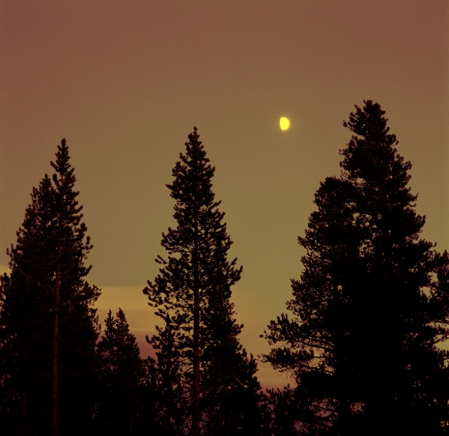
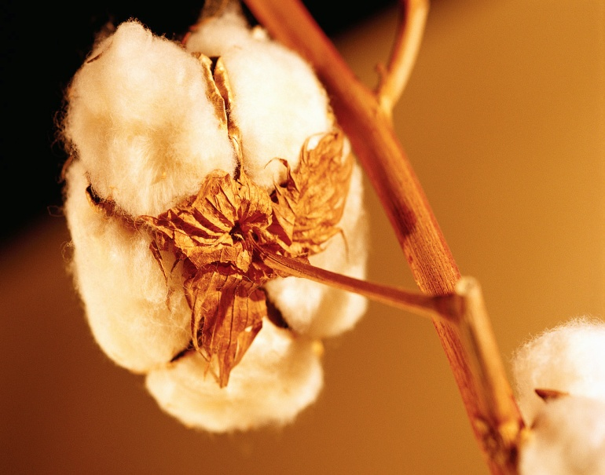
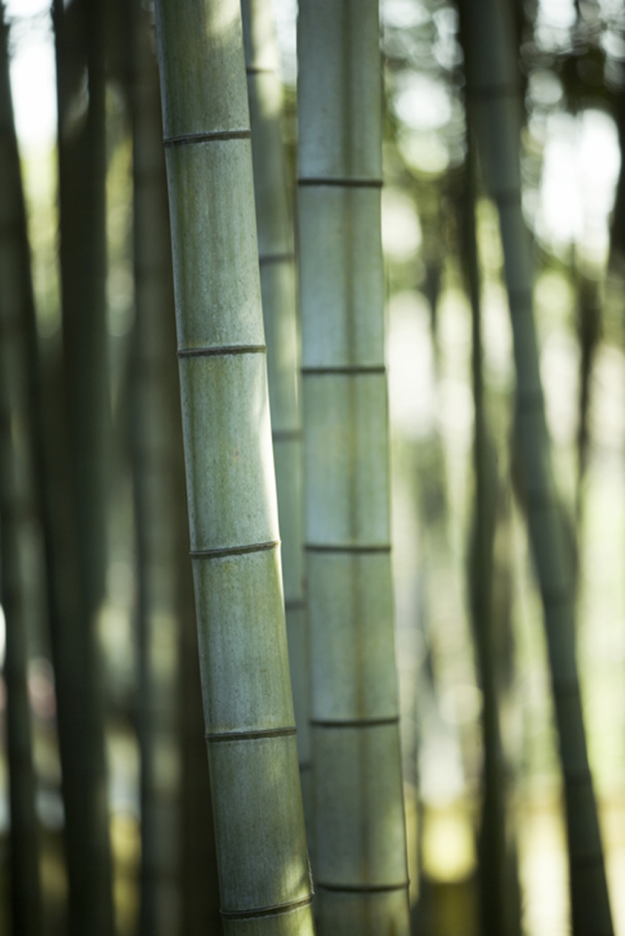
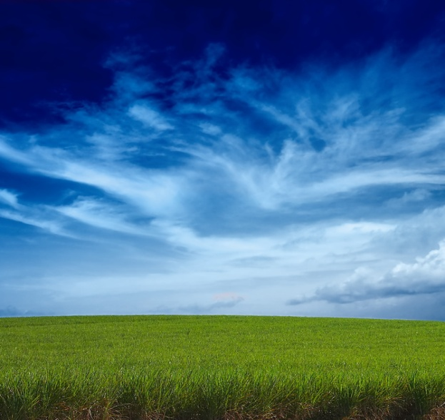
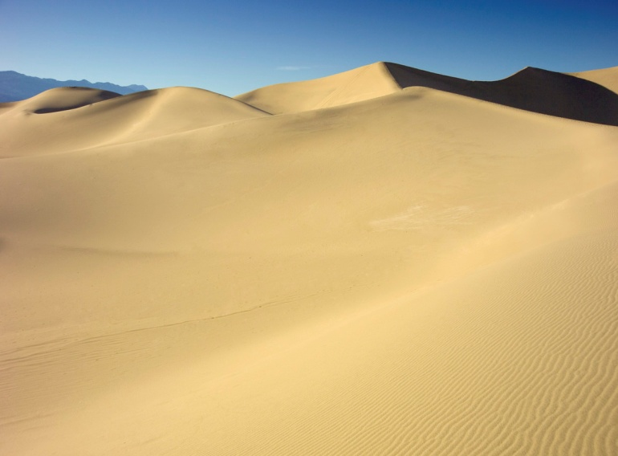
What Renewable Resources Can We Use to Build?

Slide 7
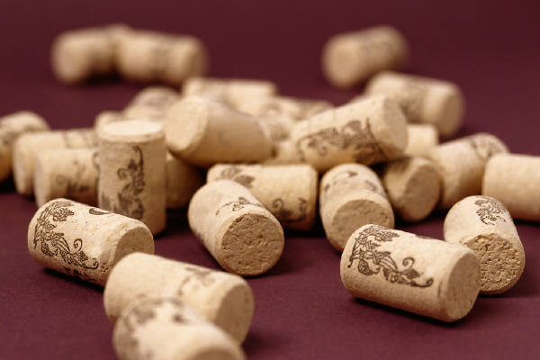

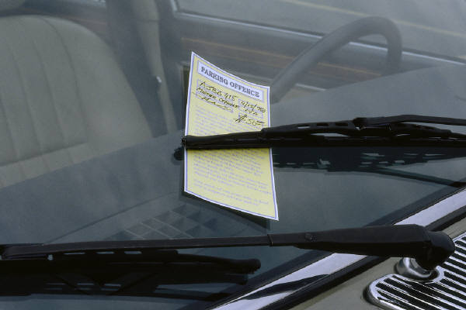
What Recycled Materials can We Use to Build? All of These!

Slide 8
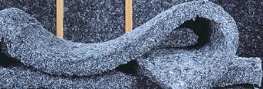
Recycled Denim Insulation
Recycled denim is used to insulate the walls of a structure, just like traditional fiberglass insulation.
The denim insulation is made of the scraps that the factories do not use.

Slide 9
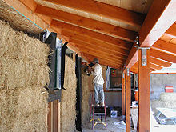
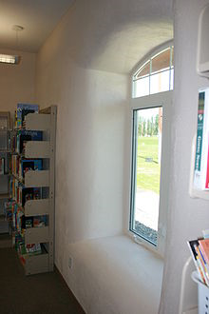
Straw Bale Construction
This type of structure doesn’t require insulation because the straw is the insulation!
Once bound together, the bales can be plastered over, and never seen again!

Slide 10
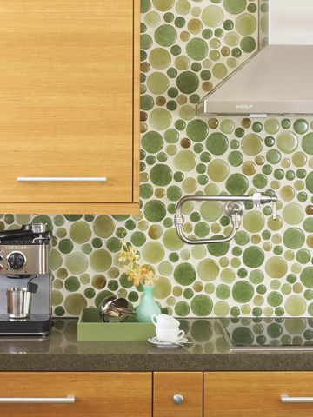
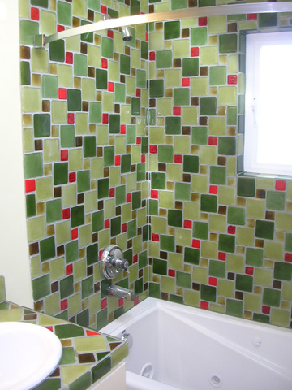
Recycled Glass Tile
-Material made from recycled glass bottles, windshields, and industrial glass waste from factories
-Comes in amazingly beautiful colors and patterns

Slide 11
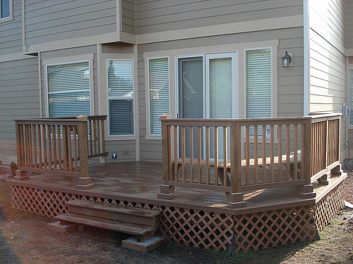
TREX “Lumber”
Material made from recycled milk jugs, water bottles, and grocery bags, mixed with wood waste
Looks and acts like traditional wooden planks and no splinters!
Use in decking, railing, fencing, trim, gutters and more!

Slide 12
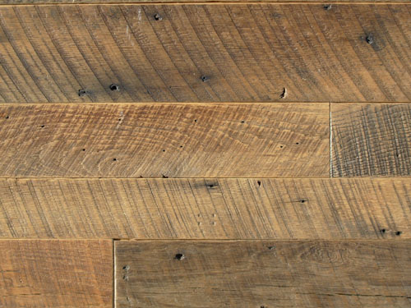
Reclaimed Wood
Used wood (“reclaimed wood”) is everywhere just begging to be saved from the landfill!
There are companies that sell reclaimed wood or you can find it yourself in homes about to be remodeled, rebuilt, demolished or re-floored and looks very nice once completed! Use reclaimed wood for any projects! It is often more beautiful than new wood!

Slide 13
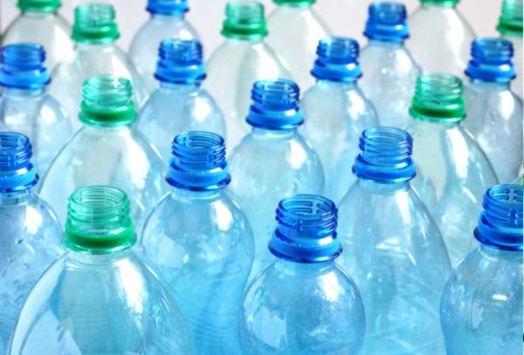
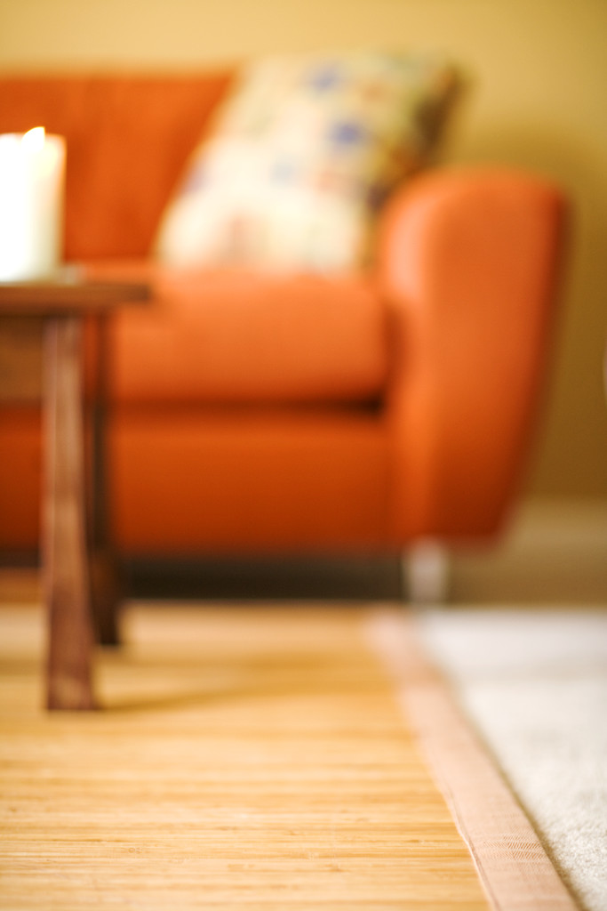
Recycled Plastic Carpeting
This carpet is made from plastic, recycled plastic water bottles to be exact!
=

Slide 14
Pass Around the Samples for Student
Exploration.
Talk about each product and ask what they think each product is made of.
Q: You used to wear me! What Am I?
A: I am recycled denim, cleverly disguised as insulation!

Slide 15
How Can I Make Sure I Am Only Buying and Using Wood Products From Sustainable Sources, and Not From the Rainforest?

Slide 16

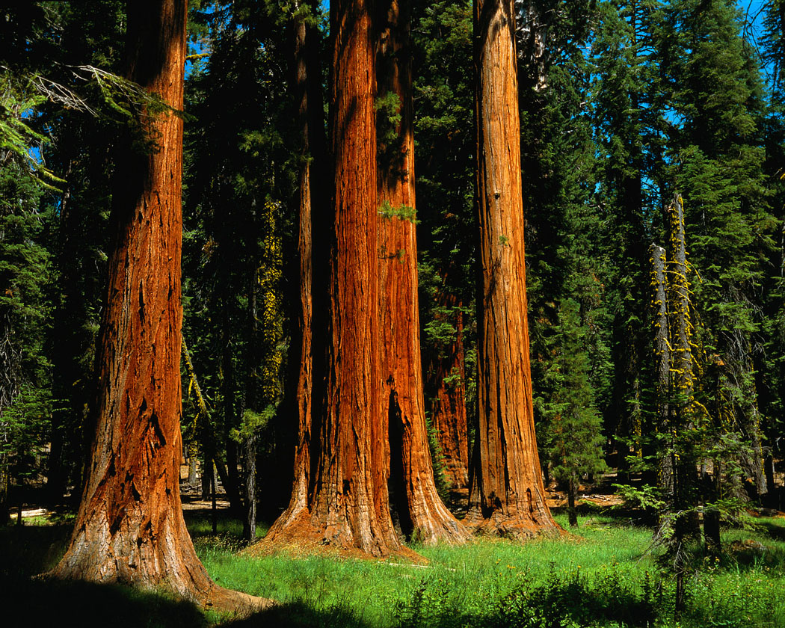
Sustainable Foresting
Forestry Stewardship Council
Began in 1993 in Germany
Main purpose: to certify wood products that are made from sustainably sourced timber so the builder knows he is building from a sustainable source and not deforesting the rainforest

Slide 17


Remember That All The Resources We Have Are Right Here On Earth. There Is NO Spaceship That Delivers Us New Resources. We have to Make Do With What We Have!
I brought you some more trees!
Thanks!

